Slide 1

JACQUEMUS BEAUTY
The Summer Body Ritual (Concept Project)
BY YAZHINI DEEPA

Slide 2
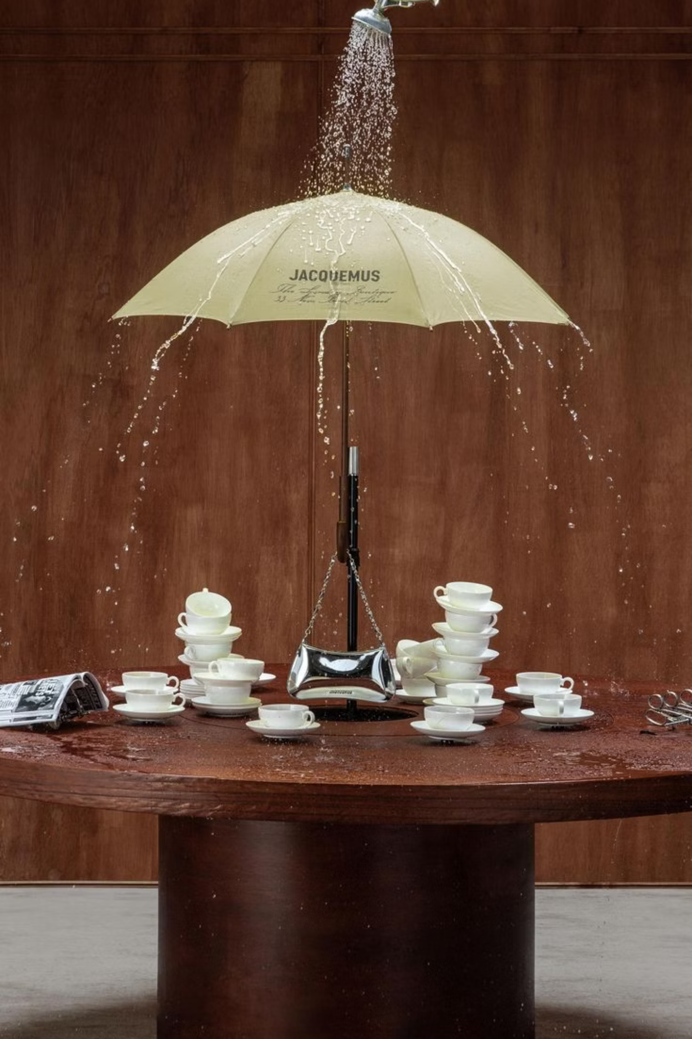
Project Overview
You know Jacquemus isn't just about the clothes, don't you? It's that feeling you get, the light, the warmth, the intimacy, the whole Mediterranean way of life. While we all recognize the brand for its incredible fashion and accessories, its unique visual language and deep emotional connection truly open the door to an entire lifestyle universe.
This project invites you to imagine Jacquemus extending its magic into beauty and body care. But this isn't just another product launch; we envision it as a beautiful, seasonal ritual. The 'Summer Body Ritual' is designed to be a calm, sensorial experience that perfectly aligns with everything you already love about Jacquemus, while truly expanding its role as the lifestyle inspiration brand.
Just so you know, this is a creative concept, a speculative idea designed to spark imagination and showcase a fresh approach to brand strategy.

Slide 3
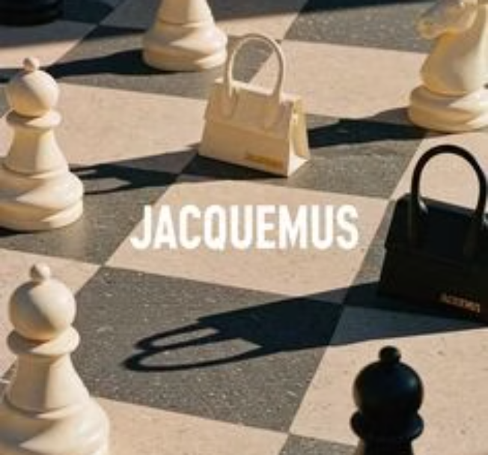
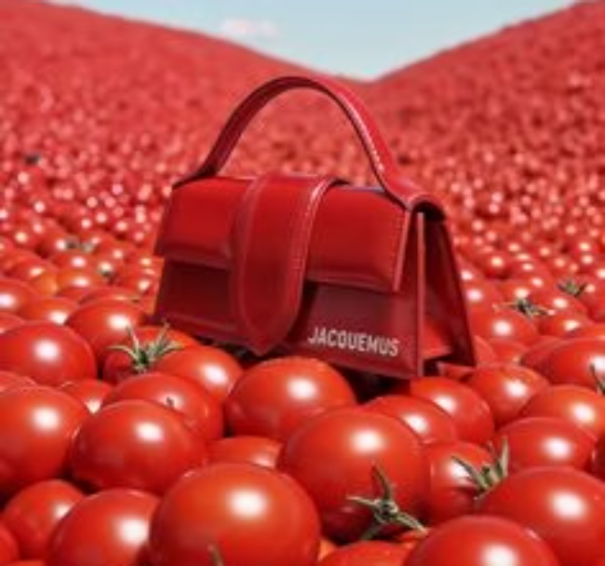
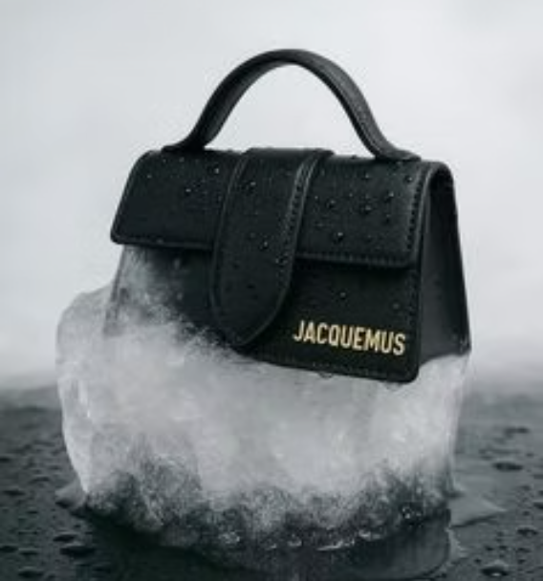
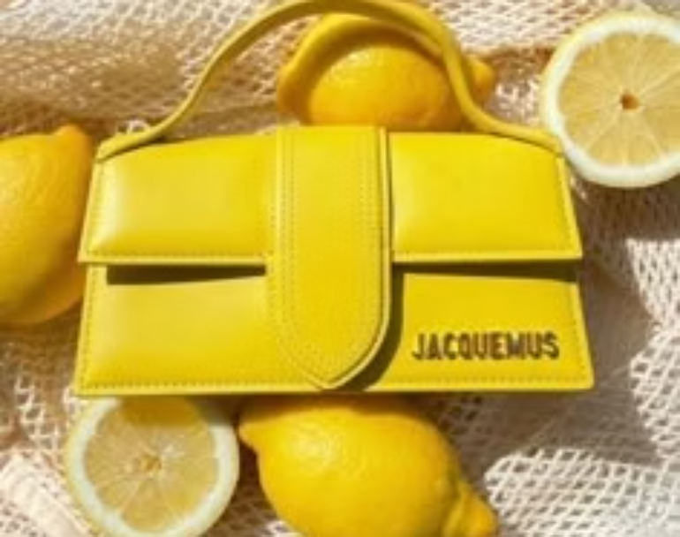
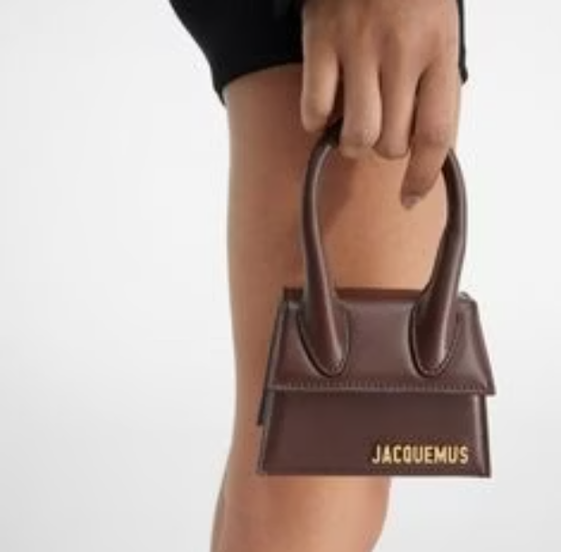
Brand Understanding
Minimalism with warmth
Playfulness without excess
Strong use of natural light and space
A balance between sensuality and simplicity
Emotional storytelling rooted in summer, the body, and ease
Rather than loud branding, the house relies on composition, texture, and feeling. The brand does not chase trends; it creates moments.
This project builds on those foundations without attempting to redefine them.

Slide 4
Creative Insight
Today, luxury is shifting from mere possessions to cherished daily rituals and intimate experiences. There's a natural craving for a slower pace and tangible products that offer genuine connection, resonating deeply rather than just being for show.
This presents an exciting opportunity: to translate that blend of indulgence, effortlessness, and deep personal connection into everyday body rituals, creating moments of luxurious and authentic self-care.
Role: Creative Strategist & Visual Director
Category: Luxury Beauty / Brand Campaign
Deliverables: Campaign image, product focus shots, visual system
Tools: Creative direction, visual strategy

Slide 5
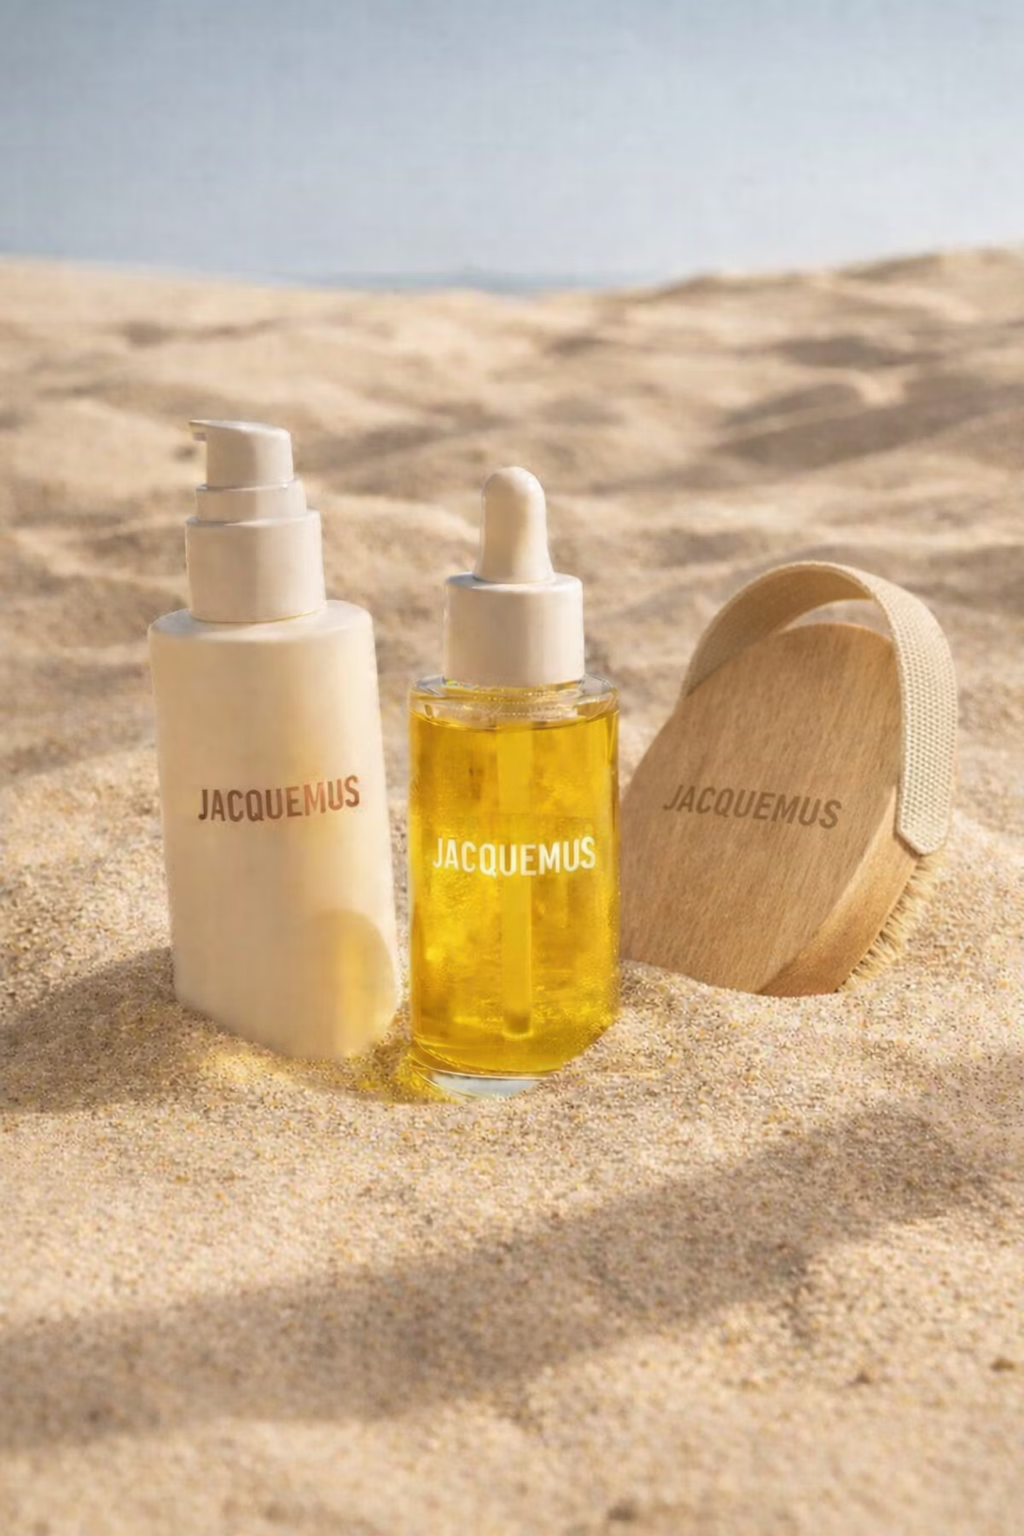
Concept: The Summer Body Ritual
A three-piece body care edit designed to be used slowly and intuitively.
The ritual focuses on touch, texture, and light, rather than transformation or correction. Each product is designed to feel like an object that belongs naturally in a Jacquemus world - understated, sensual, and timeless.

Slide 6
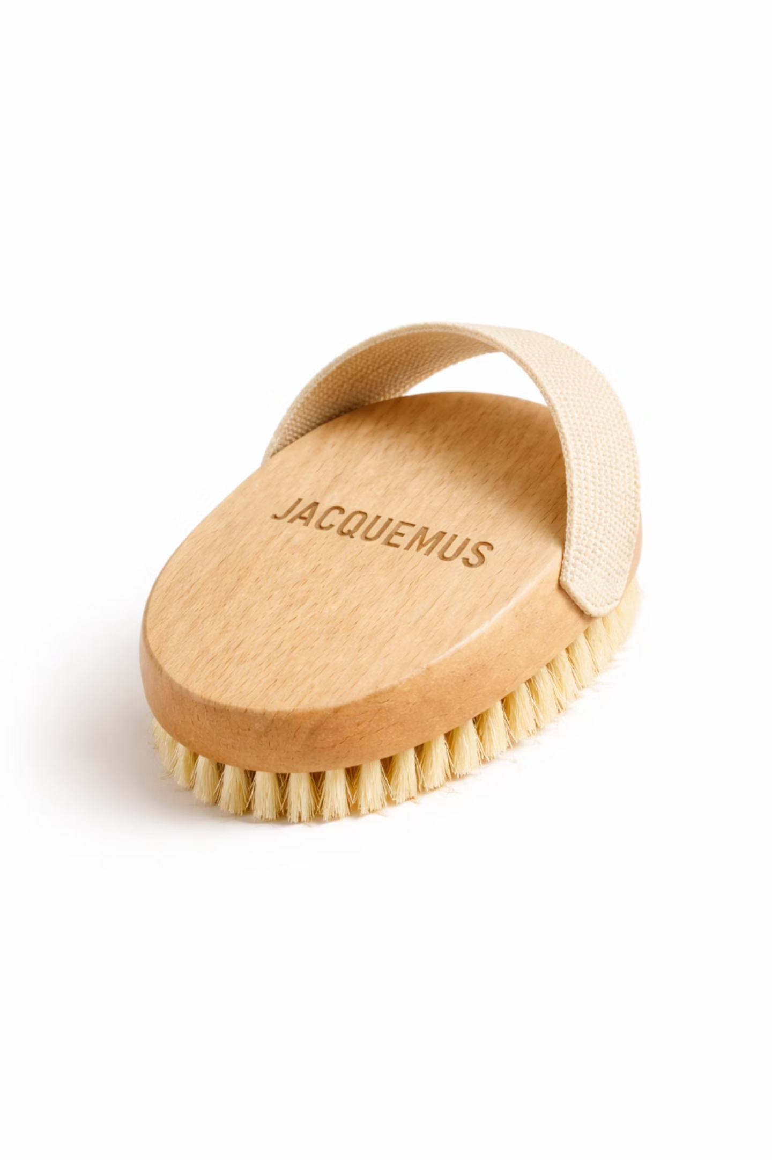
Dry Body Brush
Designed as both a functional tool and an object of design. The wooden base remains clean and minimal, while the elastic strap emerges from the underside to preserve visual purity. This detail reinforces a spa-grade, ergonomic experience where care feels intentional and unhurried.

Slide 7
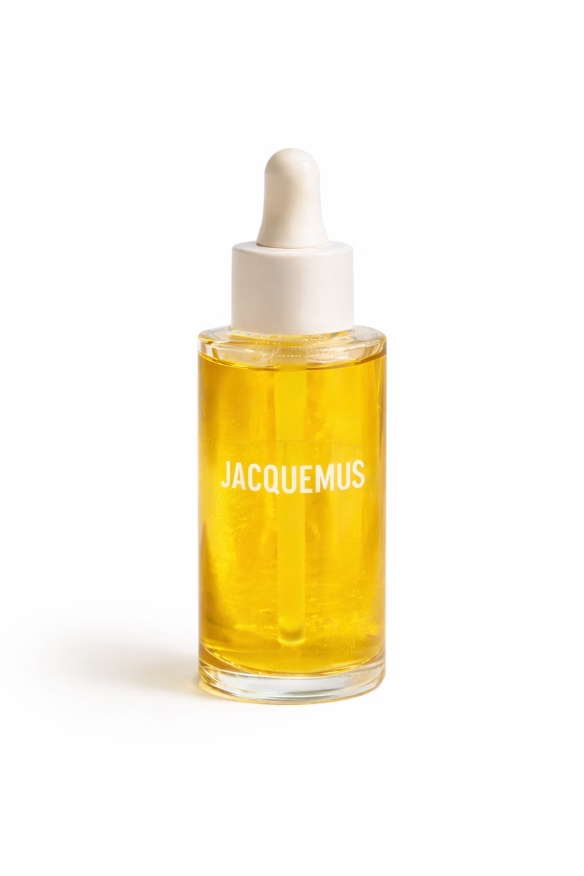
Body Oil (Serum Form)
Reimagined in a refined serum-style bottle to elevate the sensorial ritual. The oil is positioned as a moment of nourishment and glow, catching light softly without appearing decorative or excessive.

Slide 8
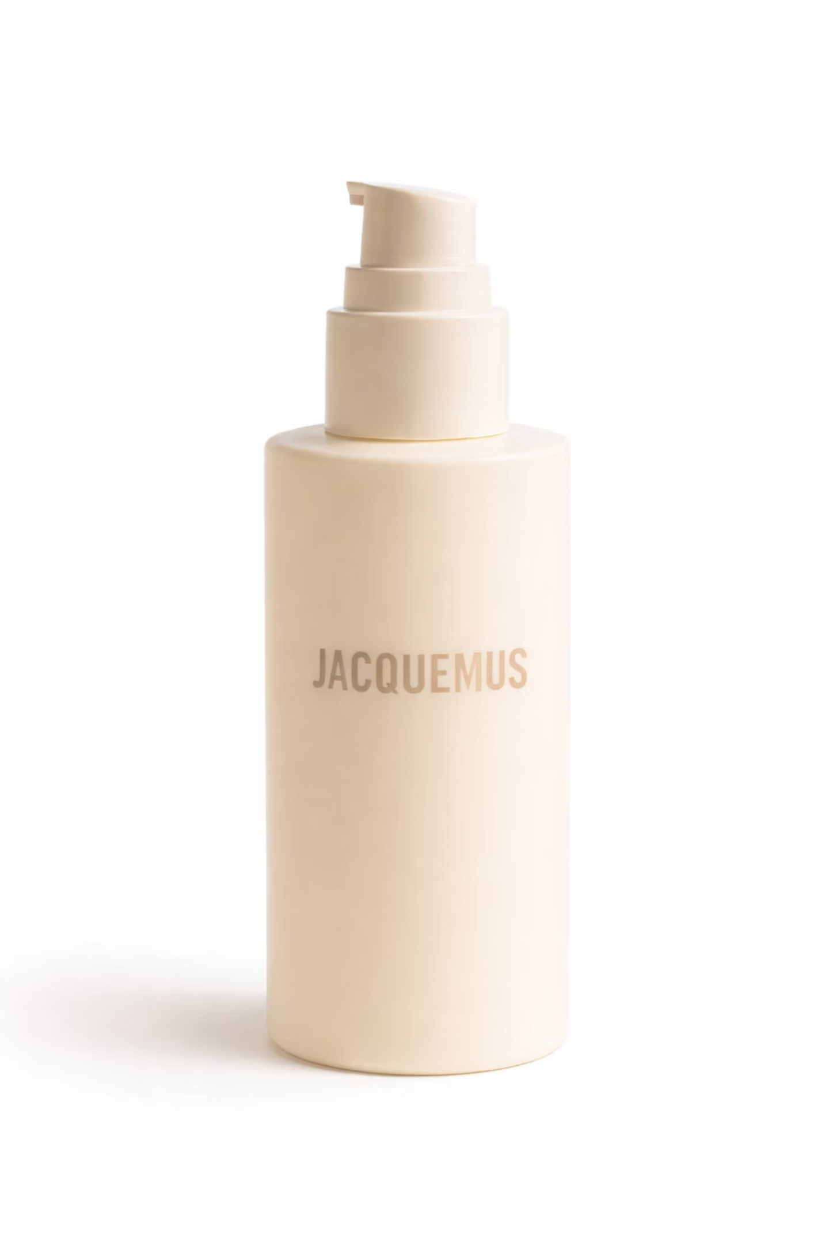
Body Lotion
A matte, sculptural form that brings balance to the trio. Placed slightly behind the other products to create visual hierarchy, it reinforces the calm, architectural compositions found in Jacquemus campaigns.

Slide 9
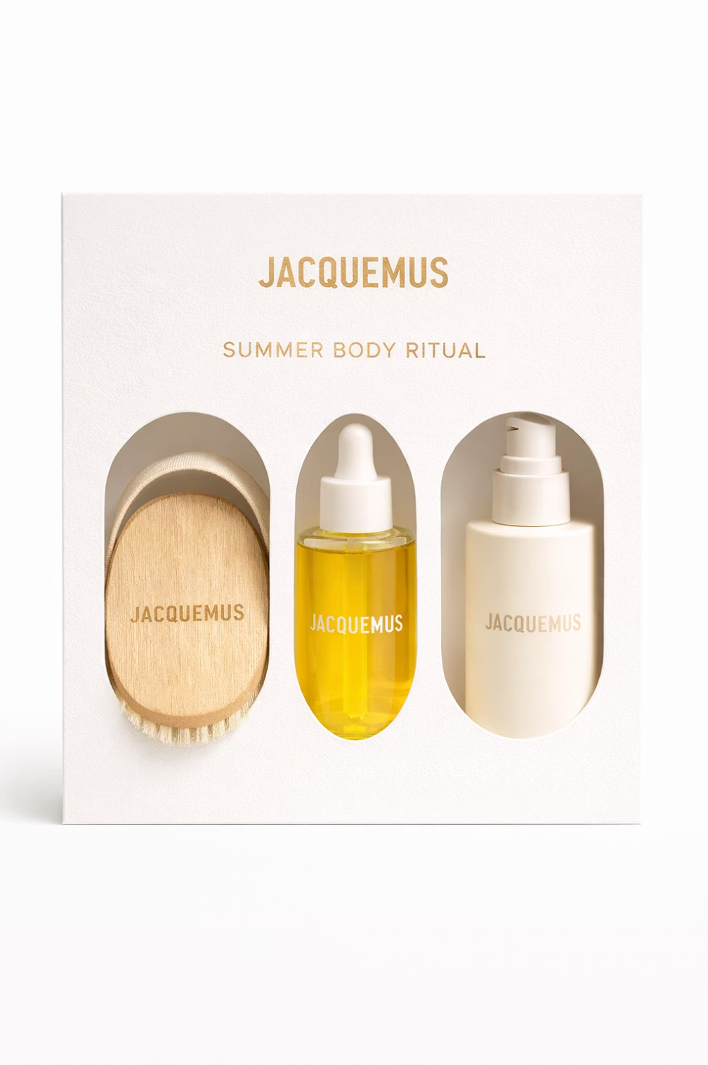
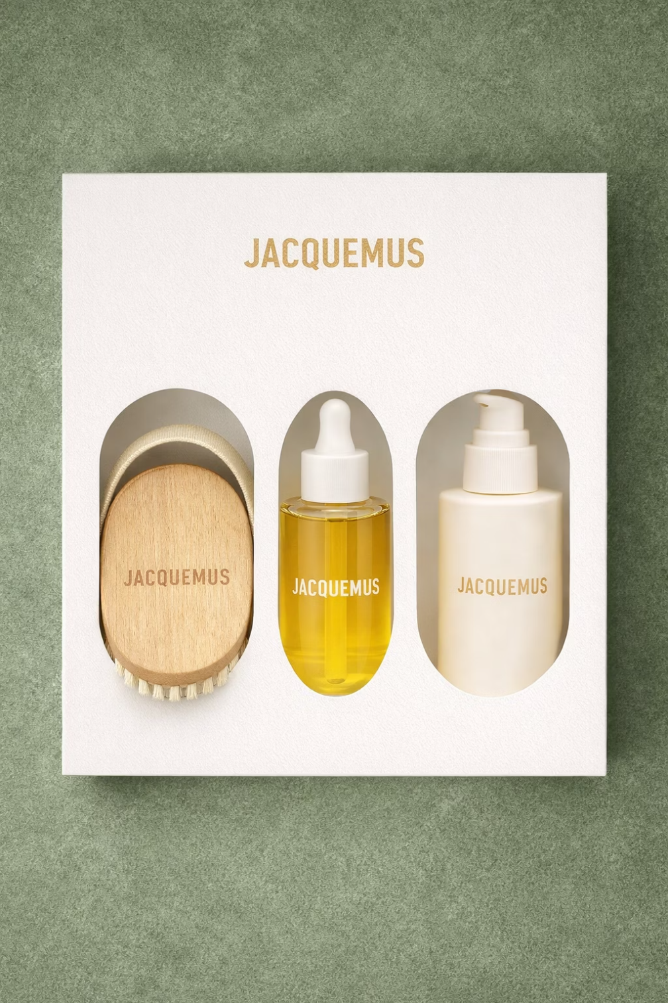
Visual Strategy
The visual language draws directly from Jacquemus’ recent campaigns:
Natural daylight
Soft shadows
Clean compositions
Mediterranean summer references
Minimal backgrounds with no visual clutter
Products are placed centrally, allowing form and material to speak. The brand name is subtly imprinted, maintaining restraint while reinforcing identity. The overall tone is luxurious, calm, and quietly playful.

Slide 10
Brand Strategy
This concept positions Jacquemus not as a beauty brand entering skincare, but as a lifestyle brand expanding its rituals.
Rather than education-driven or benefit-heavy messaging, the focus is on emotion and experience. The products exist as extensions of the brand’s world not departures from it.
The ritual approach strengthens brand intimacy while staying true to Jacquemus’ core philosophy: less explanation, more feeling.

Slide 11
Conclusion
This project does not propose a definitive direction for Jacquemus Beauty. Instead, it serves as a creative exploration, a way to demonstrate how brand identity, visual language, and cultural relevance can be translated into new categories without dilution.
It reflects my approach as a creative strategist: to observe first, interpret carefully, and expand thoughtfully.

